Slide 1
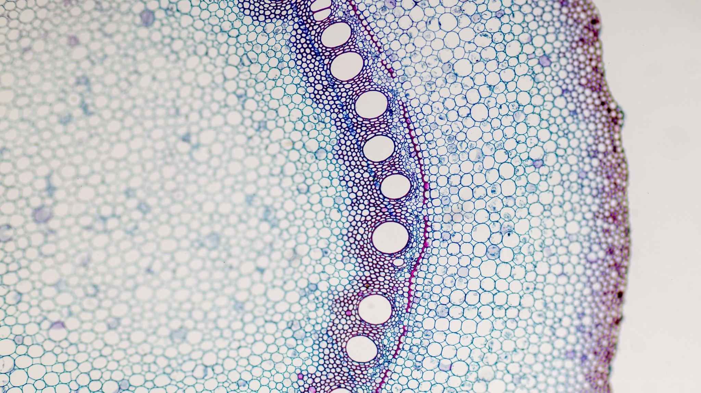
Semi-supervised cell segmentation
Dr. Sebastian Schürmann, Dobrovolskii Sergei

Slide 2
Goal
For image XYZC stacks acquired from confocal microscope we have to:
Segment
Count
Measure
The human Immune cells

Slide 3
Proposed pipeline
Mini Thesis
Random Forest semi-automated labeling, that will be used as a Training data for a Neural Network
Master Thesis:
U-Net network will be trained on the labeled data to produce the semantic segmentation or
Mask R-CNN to create Instance segmentation

Slide 4
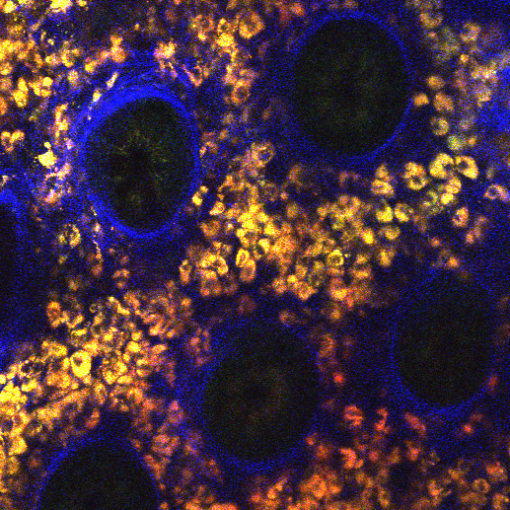
Data
A
B
A

Slide 5
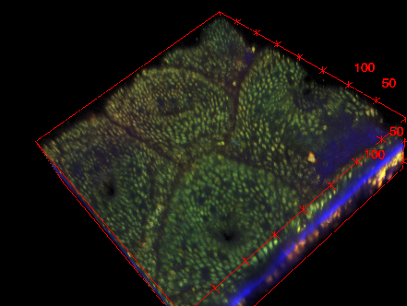
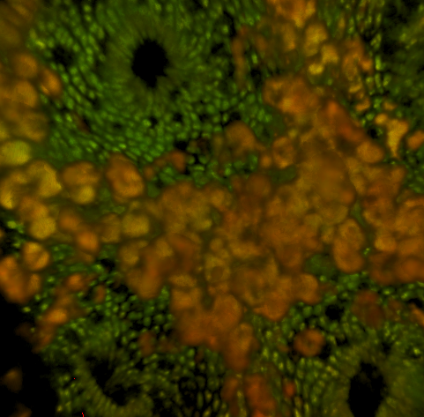
Data

Slide 6
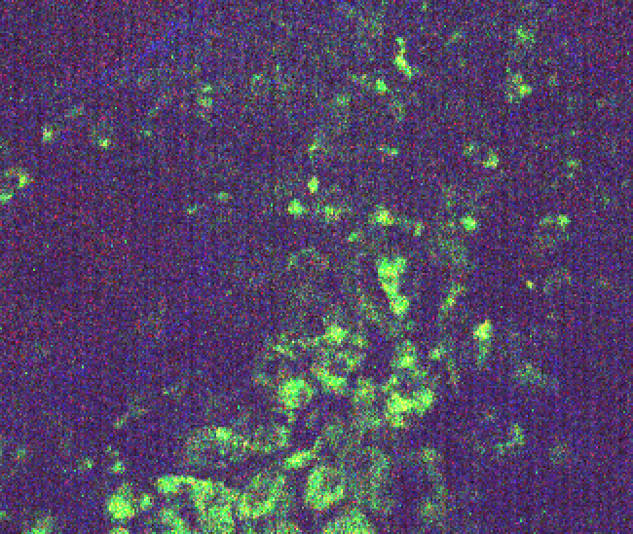
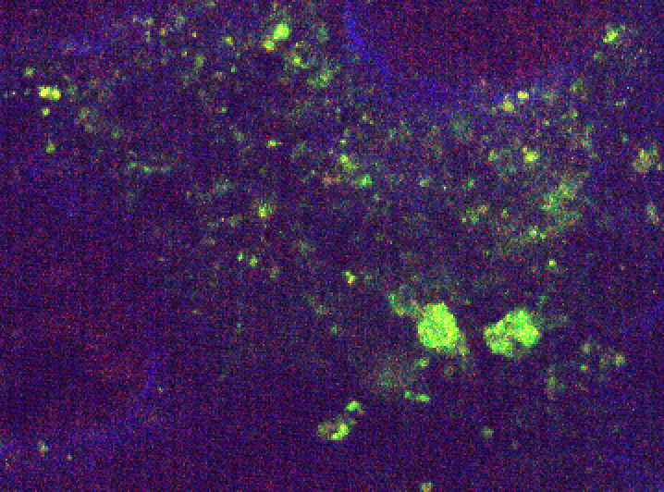
Data with noise

Slide 7
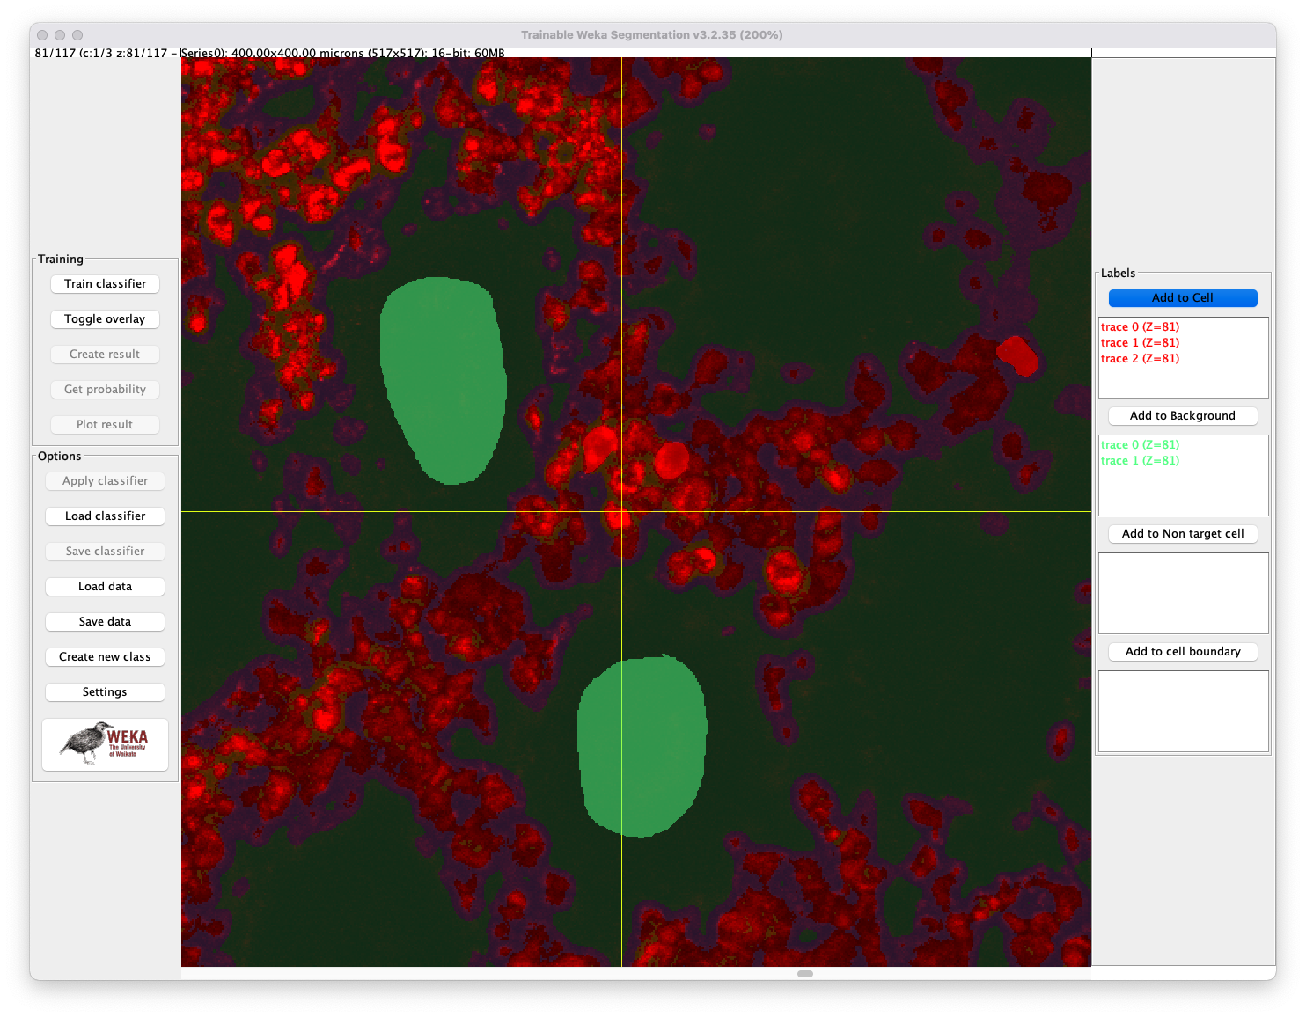
Weka segmentation plugin

Slide 8

Labeling procedure
Feature maps generation
Stack
Human Input
Random Forset classifier
Result Observation
Mask Stack
Post Processing

Slide 9
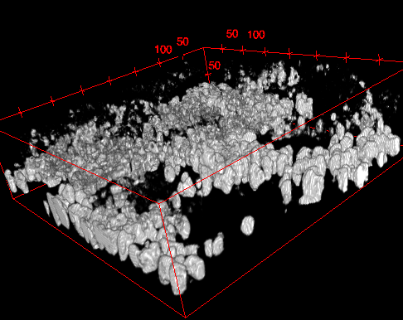
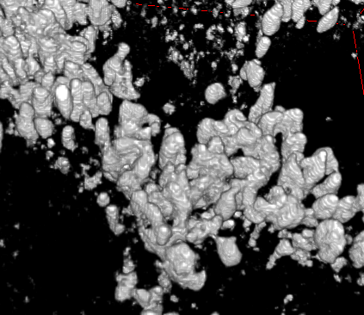
Mask before post processing

Slide 10
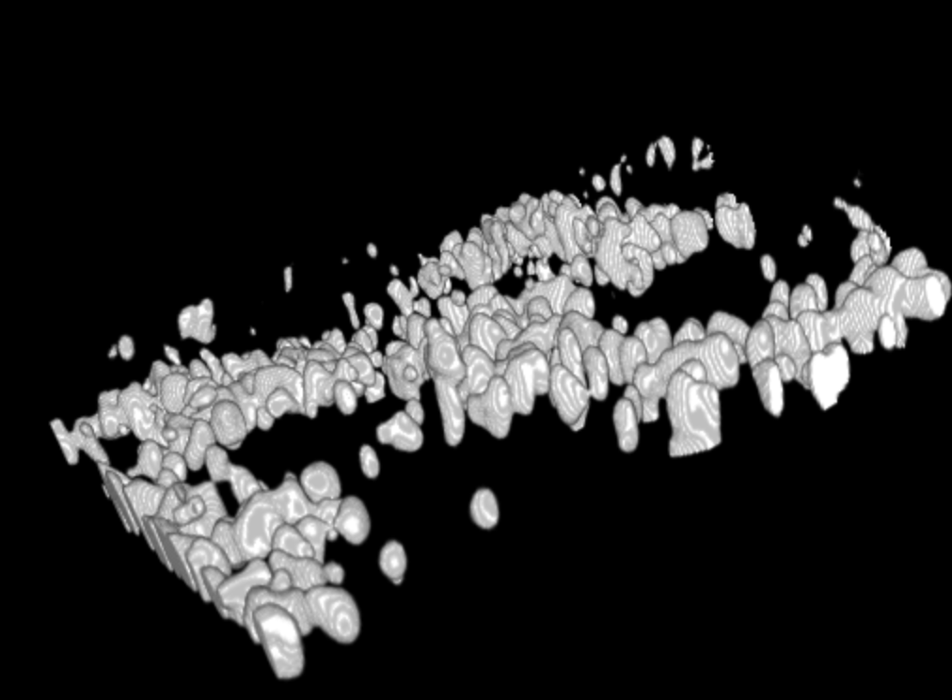
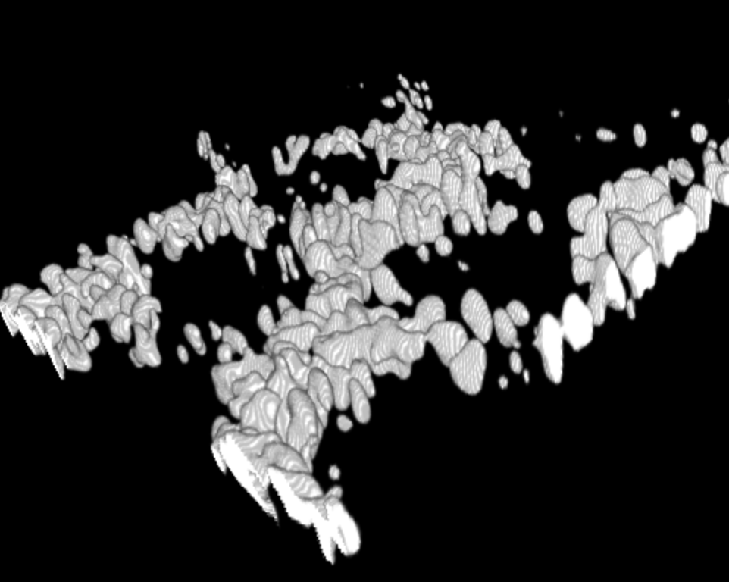
Mask after median filtering

Slide 11
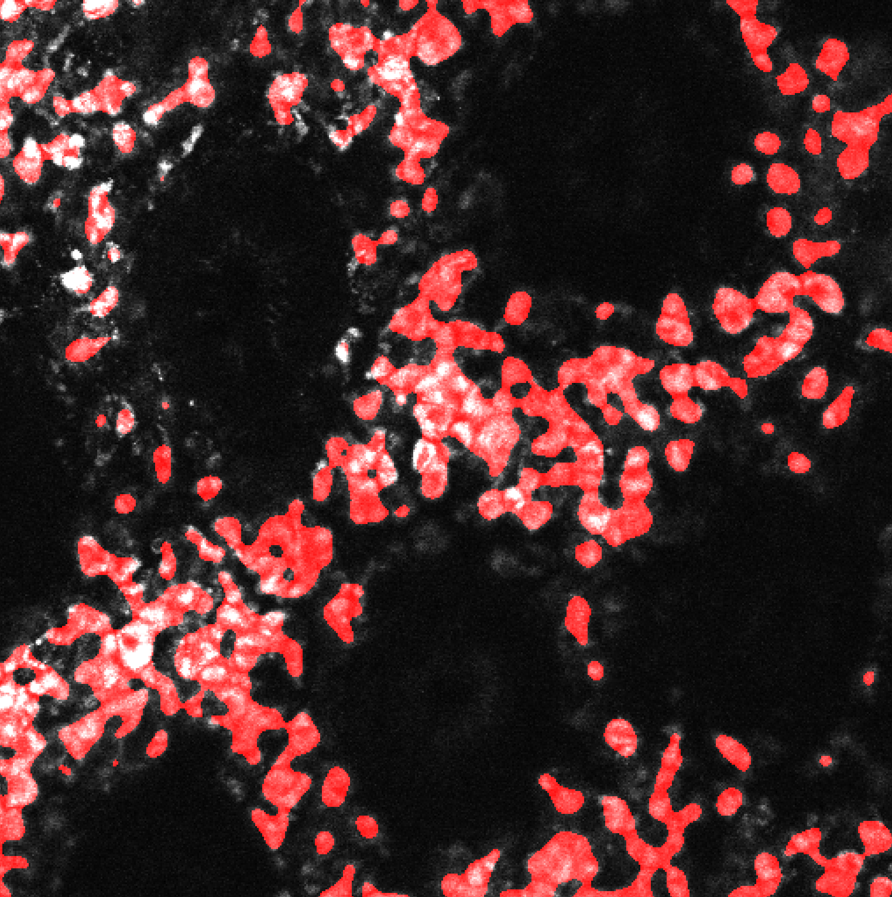
Mask overlay with one image

